Slide 1
Predictive Analytics for Hospital Bed Occupancy Management
Name: Ali abdelmeneam abdel karim
Id: 21510563
Dr. Amira Abdo

Slide 2

1- introduction 2-problem and motivation 3-Solutions 4-Literature study 5-software and functional req. 6-hardwere requirements 7-initial design 8- implementation 9-dashboard demo 10-testing and results 11-challenges 12-conclusion

Slide 3
Introduction
• Hospitals face challenges in managing bed occupancy due to unpredictable admissions.
• Overcrowding leads to delays and stress on healthcare workers.
• Predictive analytics can optimize resources and improve patient care.

Slide 4
Problem and motivation
• Overcrowding increases wait times and reduces care quality.
• Underutilization wastes resources and impacts financial stability.
• A predictive system is needed to forecast trends and improve planning.

Slide 5
Solutions and deliverables
Deliverable: A machine learning-based prediction + web dashboard
Features: Data intake , Trend forecasting and Streamlit interface
Purpose: Help hospitals predict section crowding 3 to 6 month ahead

Slide 6

Literature Study
• Review of traditional approaches (Manual planning , Historical data usage).
• Common limitation : Rigid assumption , low adaptability .
• Machine learning offers a more robust solution.
•ML models used in healthcare : Random forest, logistic regression , SVM
•Key sources cited : Hall & harhoff , Bessen & Meurer .
•Highlight : Gap in usable interfaces for hospital admin teams.

Slide 7
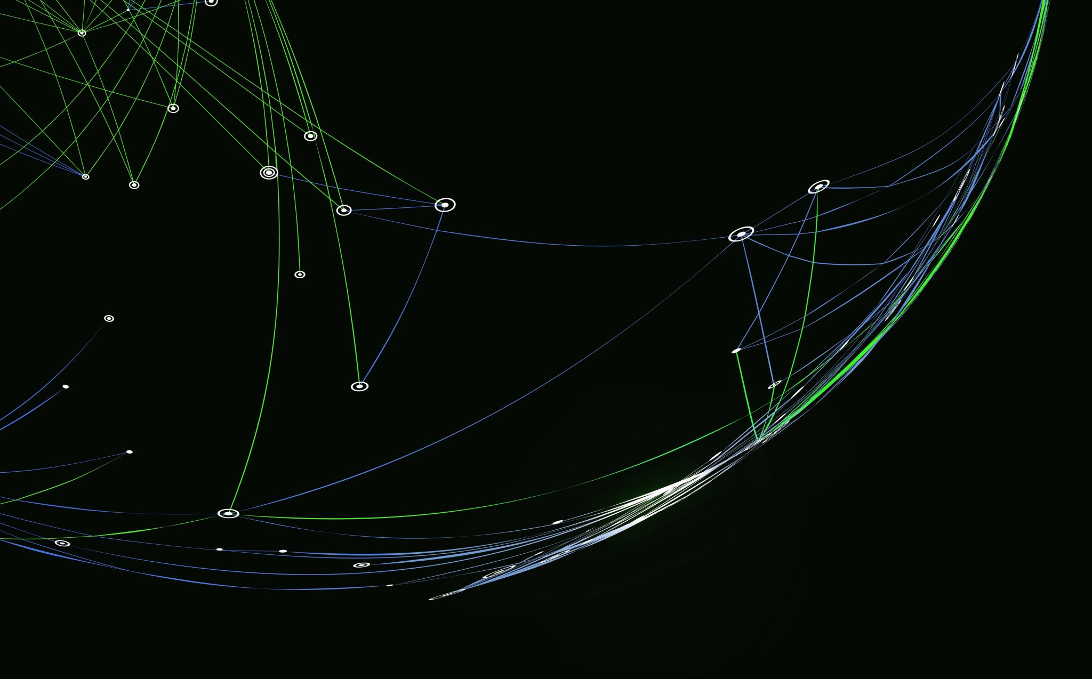
Software and functional requirements
• Python , pandas, scikit-learn, Streamlit and vs code.
• Data source: simulated or real historical patient data.
• Functional : predict if ICU/ER will be crowded or not in 3 to 6 month.

Slide 8

HarDware requirements
-Basic pc/ Laptop (No GPU needed).
- Web hosting (optional for deployment).
- Suitable for local or cloud deployment.

Slide 9

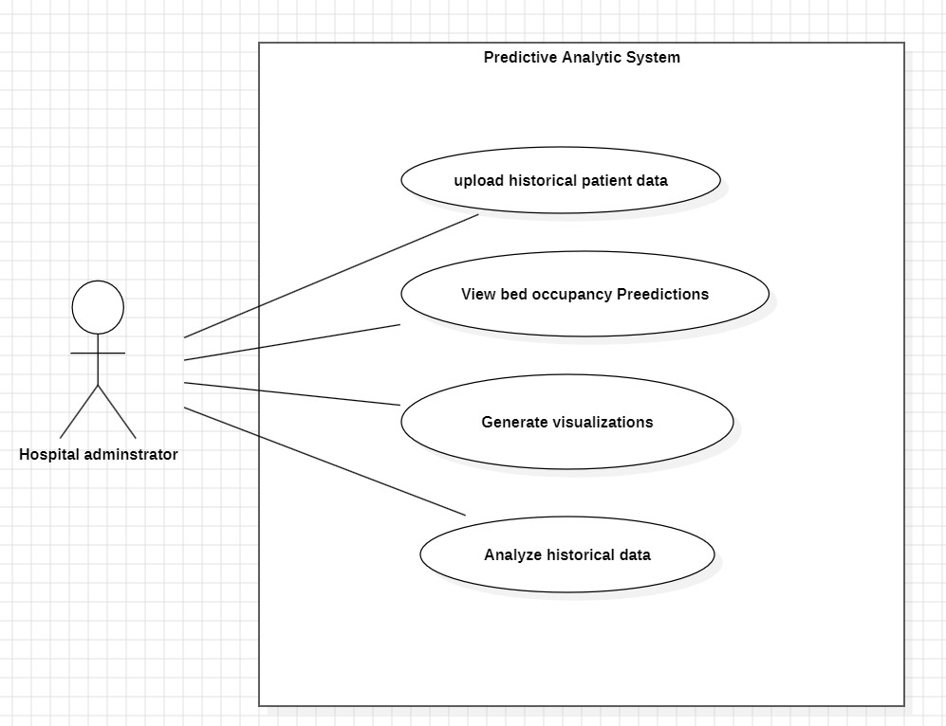
Initial design diagrams(use case diagram)

Slide 10
IMPLementation
1.Ml pipeline: data reprocessing , model training, model saving
2. Model: RandomForestClassifier trained on time-series + categorical data.
3. Integration: pickle model + streamlit dashboard.

Slide 11
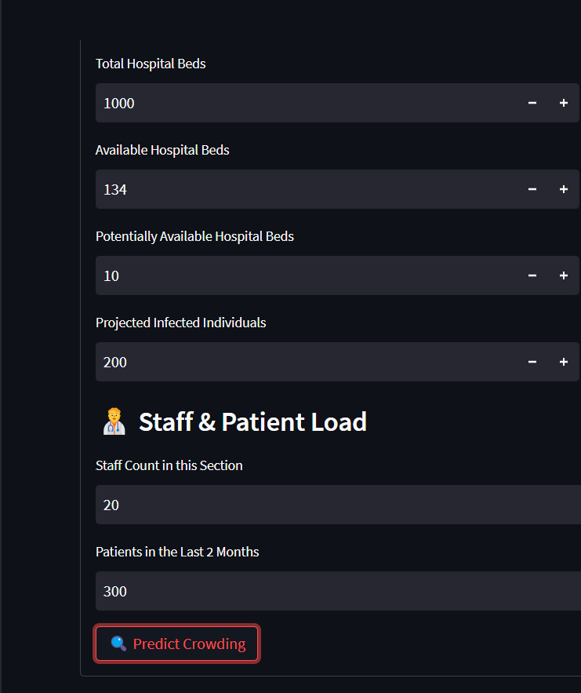
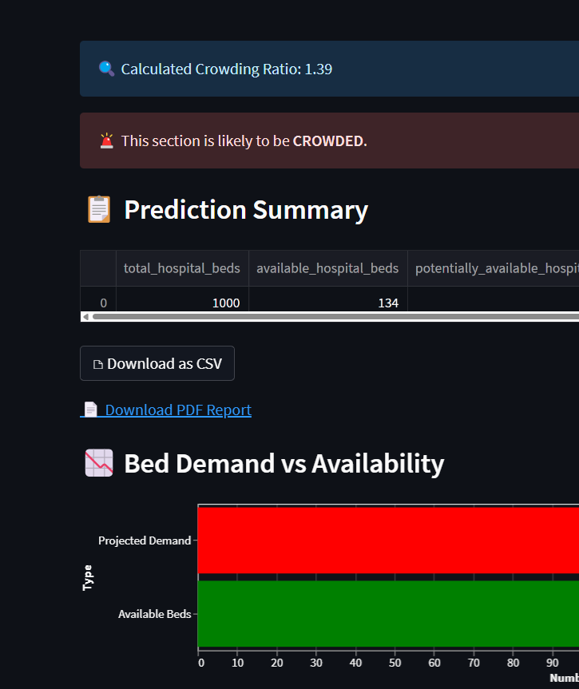
Dashboard demo & workflow
Step 1: Staff inputs data from the hospital system
Step 2: Submits the form
Step 3: System returns an easy-to-read prediction
Goal: Simple interface – no technical knowledge needed

Slide 12

Model accuracy & evaluation metrics
• After training and validation , the following performance metrics were obtained .
Training Accuracy: 95%
Testing Accuracy: 87%
Precision: 84%
Recall: 82%
F1-Score: 83%
•These metrics indicate that the model generalizes well to unseen data and balances both false positives and falsa negative effectively .
The machine learning model was trained to classify whether a hospital section is likely to be crowded in the next 3-6 months

Slide 13

Confusion Matrix Overview
• Predictive analytics improves hospital operations.
 | Predicted: Crowded | Predicted: Not Crowded
Actual: Crowded | 45 (True Positives) | 5 (False Negatives)
Actual: Not Crowded | 6 (False Positives) | 44 (True Negatives)
True Positives (TP): Model correctly predicted crowded.
False Positives (FP): Model wrongly predicted crowded.
False Negatives (FN): Model missed a crowded section.
True Negatives (TN): Model correctly predicted not crowded.
This matrix helps evaluate how well the model distinguishes between crowded and not crowded sections.

Slide 14

Challenges and limitations
Training/testing accuracy
Confusion matrix / precision / recall
Note: model performs well on synthetic/test data

Slide 15
Conclusion and future work
Summary: ML helps predict overcrowding in ICU, ER, etc.
Future: add live data updates, department-specific models, staffing prediction

Slide 16
Thank you

